Slide 1
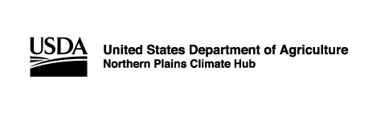
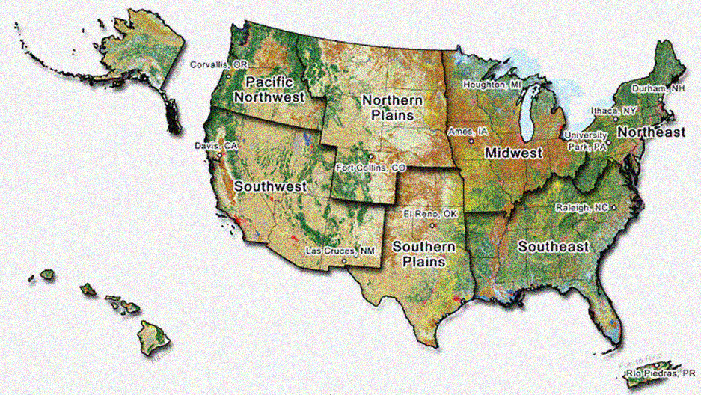
USDA Northern Plains Climate Hub
Climate information benefiting agriculture
Dannele Peck, Director
dannele.peck@usda.gov
Northern Plains Weather & Climate Workshop
Fargo, ND – March 28, 2019

Slide 2
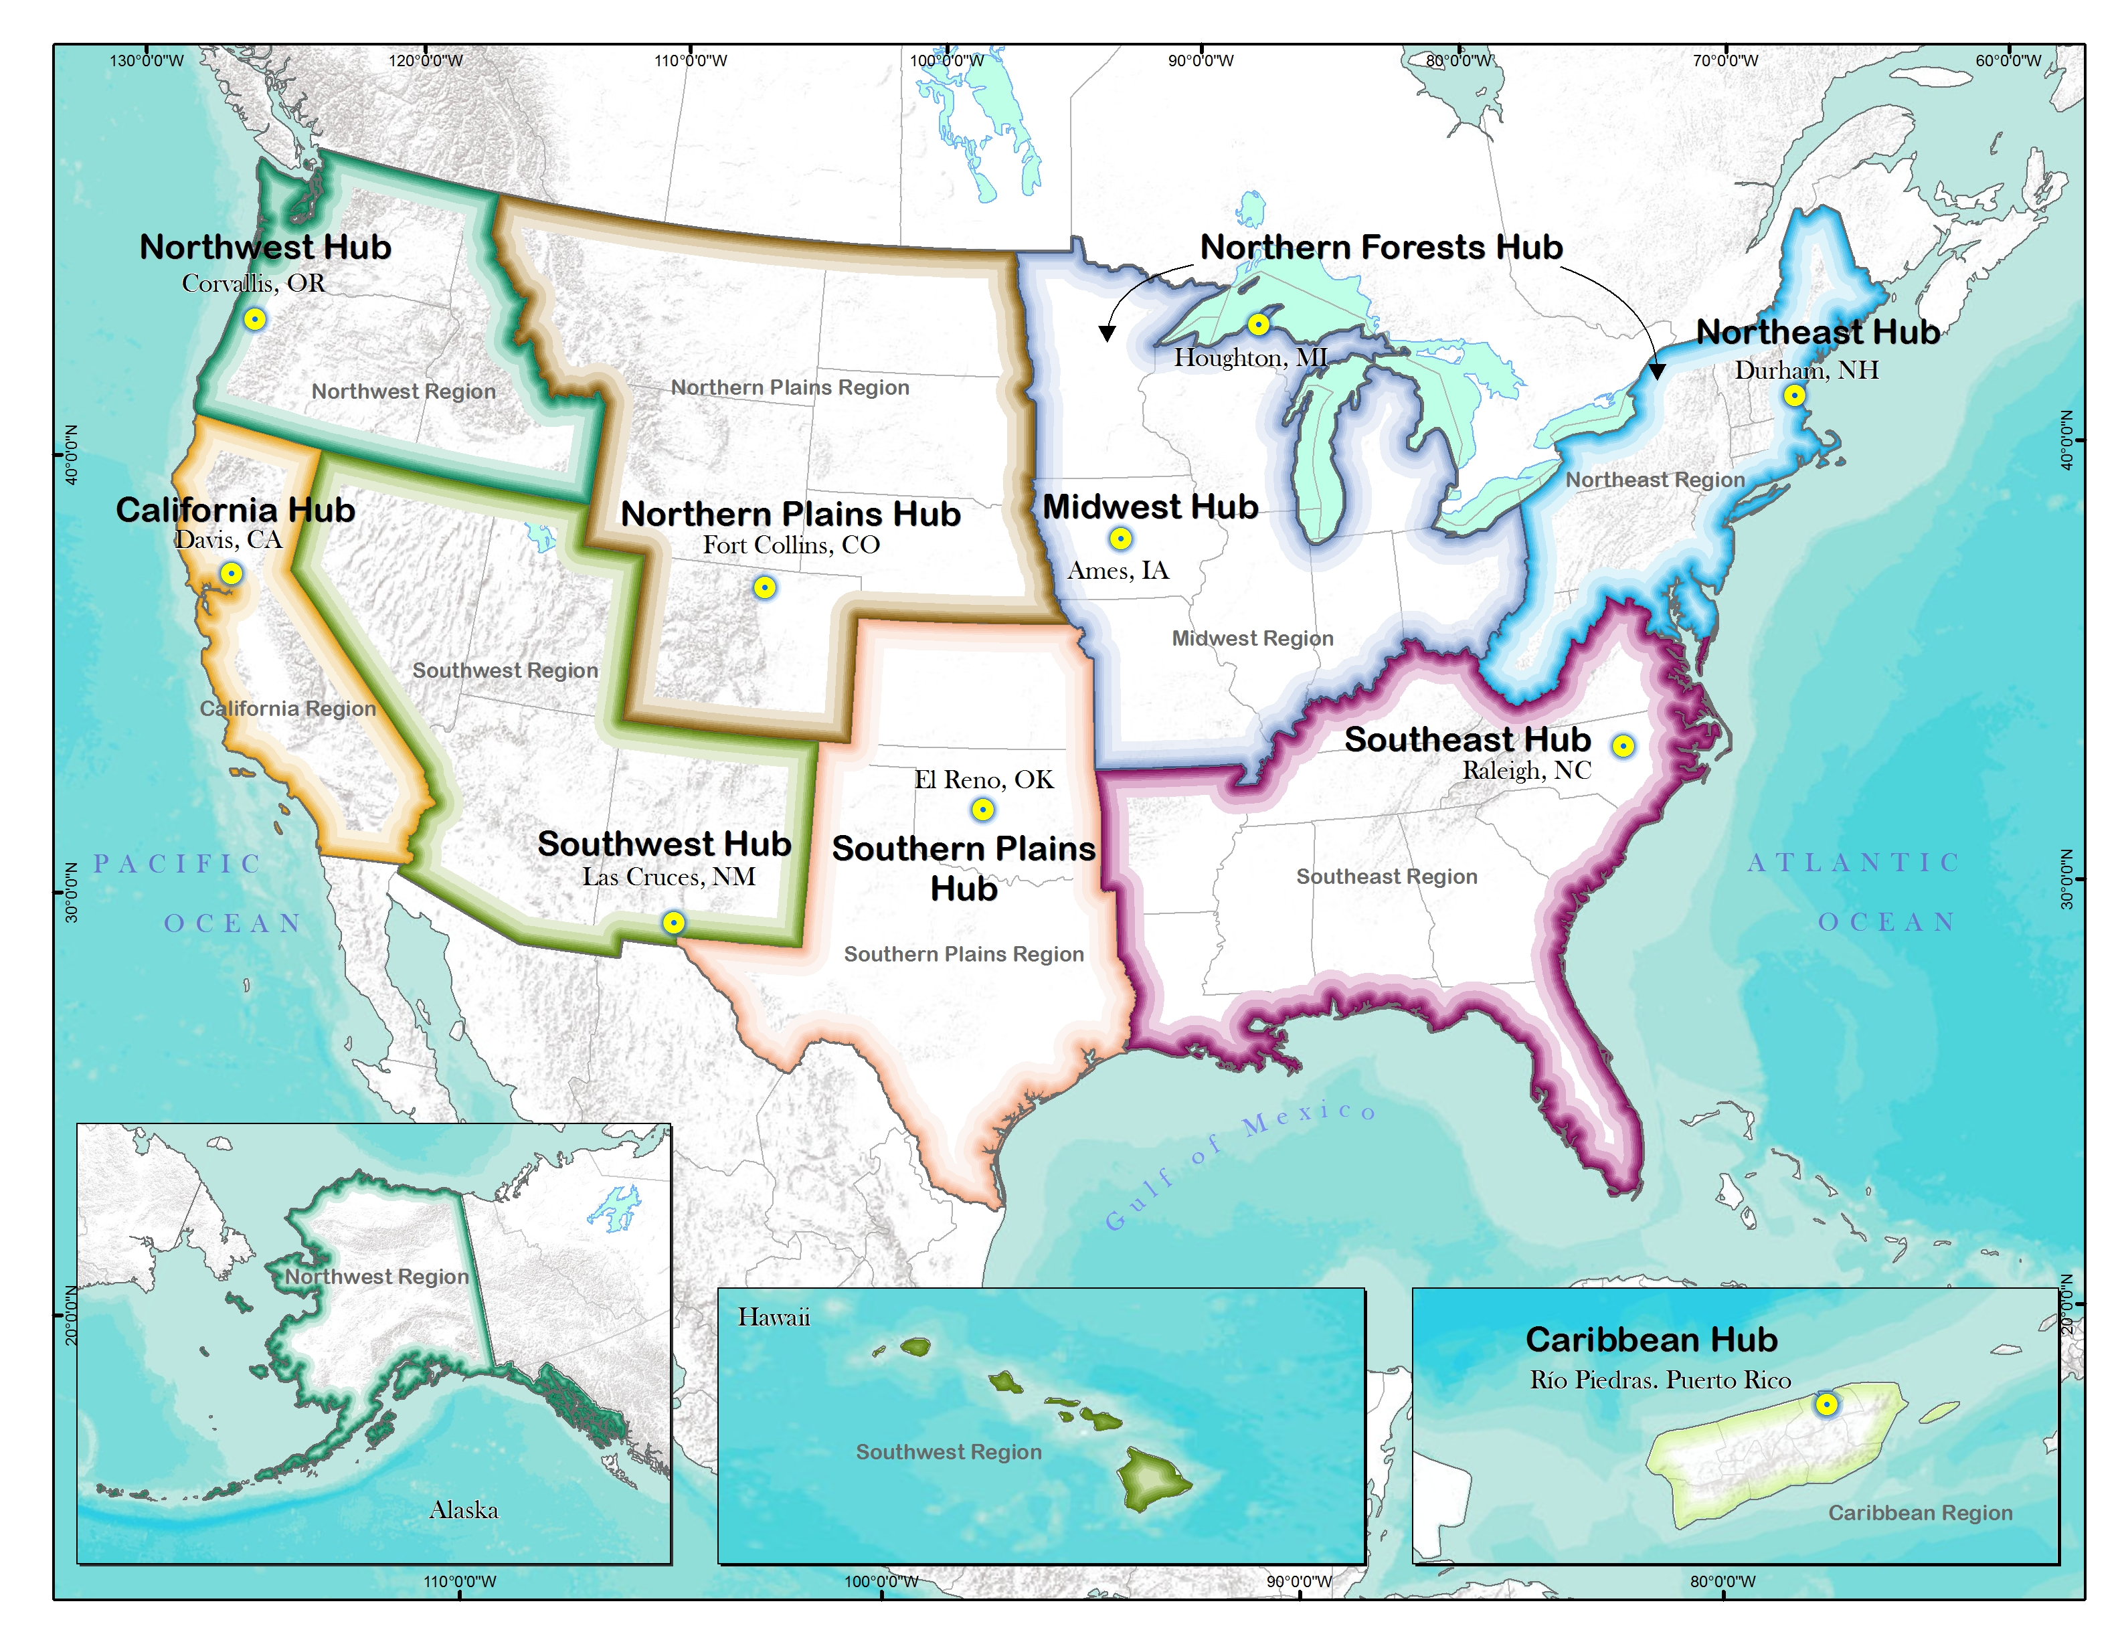
USDA Climate Hub Network
Notes:
Emile

Slide 3
USDA Climate Hub Network
Vision:
Robust & healthy agricultural production and natural resources under increasing climate variability and change
Mission:
Co-Develop science-based, region-specific info & tech, with USDA agencies and other partners
Co-Deliver these to ag & natural resource managers to enable climate-informed decisions
Notes:
Emile

Slide 4
Hubs’ Guiding Principles
Operate in 3 functional areas
  Science translation and information synthesis
  Tool development and technology transfer
  Stakeholder outreach and education
Work at the interface of science and services
  Interpret, engage stakeholders, refine, deliver, repeat!
Span boundaries by fostering partnerships
  Agriculture Industry ↔ Climate/Weather Scientists
  Across USDA agencies (ARS, FS, NRCS, FSA, APHIS…)
  USDA ↔ Other Federal depts/agencies (DOI, NOAA,…)
  USDA ↔ Tribes, States, NGOs, industry, producers
Notes:
Dannele
Hubs are integrated into ARS research
Understanding ‘a day in the life’ of a Hub director.

Slide 5
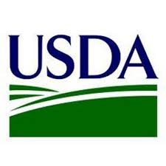
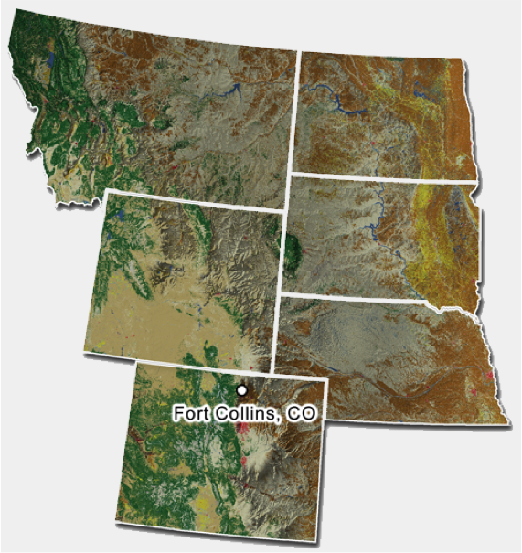
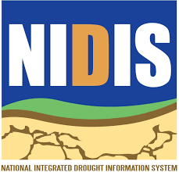
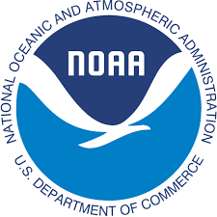
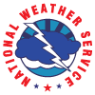
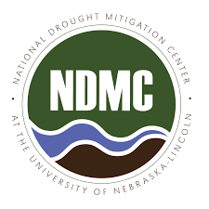



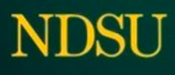
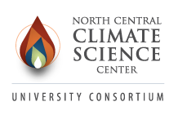

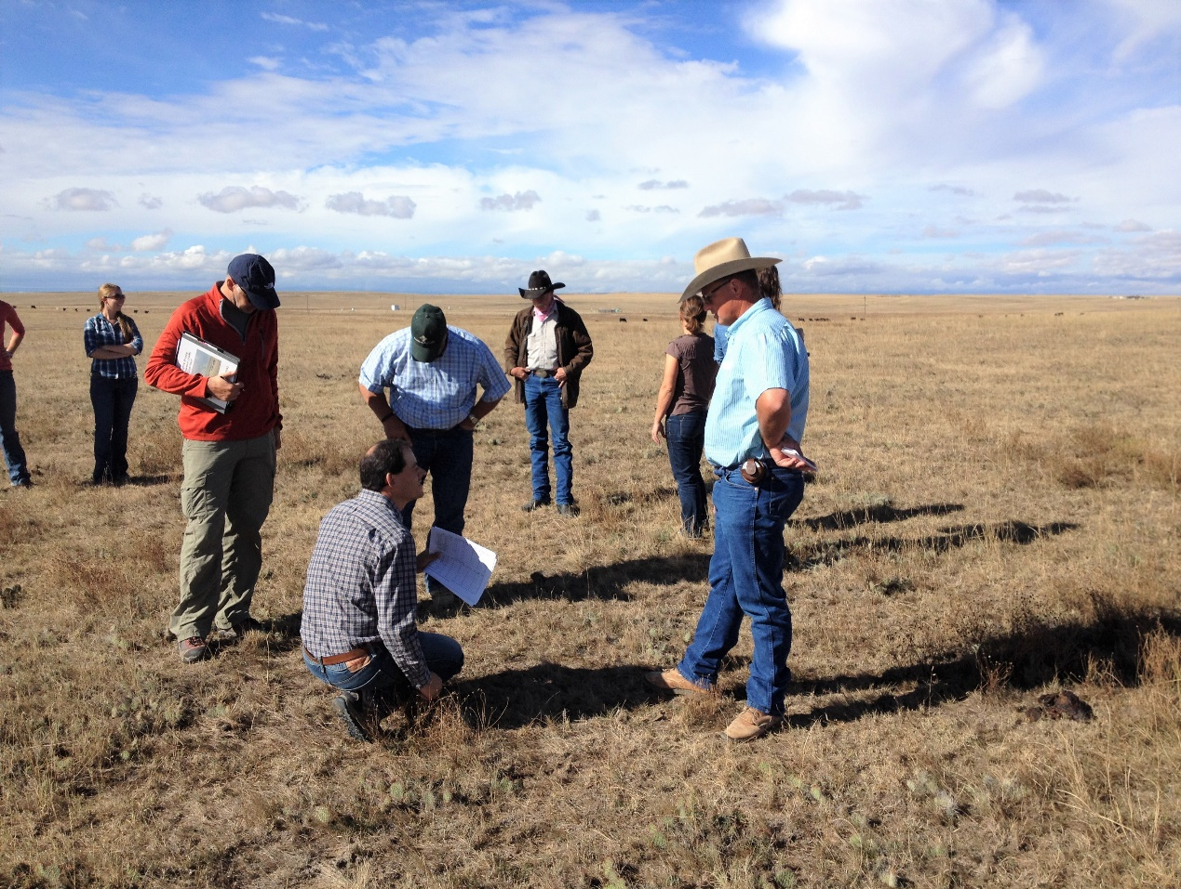





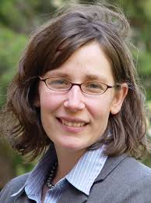
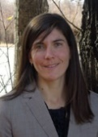
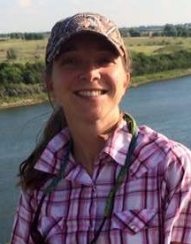
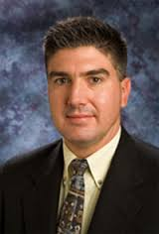
How does NP Climate Hub work?
Working-Land Managers & Service Providers
Notes:
-The Northern Plains Climate Hub consists of a small team of full-time staff (in the lower right corner) based in Fort Collins, CO. Because we are such a small team, we rely heavily on PARTNERSHIPS to get lots of great things done!
-How this typically works is that a working-land manager like this farmer in the upper-left corner will encounter a weather or climate related challenge, question or idea. They reach out first (CLICK) to their trusted partners in the field, perhaps a University Extension educator or researcher, or a crop consultant or Conservation District representative.
-Now these tech-transfer partners typically aren’t trained in weather or climate science, so we can’t expect them to have all the answers! But hopefully they know someone here at the Climate Hub (CLICK) and think to give us a holler.
-Again, we’re a pretty small team, so we don’t always have the expertise or resources right within our office. Lucky for us, we have a HUGE network of partners (CLICK) who ARE the experts on weather and climate science! And we speak just enough of both languages—climate and agriculture—that we can relay the problem/question to them in a way they understand, and receive the resulting scientific information (CLICK), but then help translate their answer in a way our agricultural stakeholders will understand (often by working collaboratively with both groups).
-Once we have the answer or information in a format our tech-transfer partners and stakeholders agree is useful, we help distribute that information (CLICK) back out to our tech-transfer colleagues, who then carry it back to the working land managers (CLICK) who can hopefully benefit from it.
-In the process of doing all of this, a wonderful by-product is the fostering of new and stronger relationships (CLICK) between our tech-transfer partners and our friends in the weather and climate science world! These new connections hopefully lead to more frequent conversations and collaborations between these two worlds, so that our weather and climate-science friends gain a better understanding of agriculture and its needs, and our friends in agriculture gain a better understanding (and trust) of weather and climate information.
-In summary, the Climate Hub’s partners include University Extension educators and researchers; USDA researchers, programs, and field offices; private sector companies addressing climate change adaptation and mitigation; farm groups; state, local and regional governments; tribes; NOAA and DOI regional climate change experts; and non-profits providing assistance to landowners. The Hubs work to connect with and meet the needs of rural, tribal and underprivileged groups to help them sustain their working lands.

Slide 6
How does NP Climate Hub work?
4
Working-Land Managers & Service Providers
3
2
Networks & Partnerships are the Key!
1
Notes:
-The Northern Plains Climate Hub consists of a small team of full-time staff (in the lower right corner) based in Fort Collins, CO. Because we are such a small team, we rely heavily on PARTNERSHIPS to get lots of great things done!
-How this typically works is that a working-land manager like this farmer in the upper-left corner will encounter a weather or climate related challenge, question or idea. They reach out first (CLICK) to their trusted partners in the field, perhaps a University Extension educator or researcher, or a crop consultant or Conservation District representative.
-Now these tech-transfer partners typically aren’t trained in weather or climate science, so we can’t expect them to have all the answers! But hopefully they know someone here at the Climate Hub (CLICK) and think to give us a holler.
-Again, we’re a pretty small team, so we don’t always have the expertise or resources right within our office. Lucky for us, we have a HUGE network of partners (CLICK) who ARE the experts on weather and climate science! And we speak just enough of both languages—climate and agriculture—that we can relay the problem/question to them in a way they understand, and receive the resulting scientific information (CLICK), but then help translate their answer in a way our agricultural stakeholders will understand (often by working collaboratively with both groups).
-Once we have the answer or information in a format our tech-transfer partners and stakeholders agree is useful, we help distribute that information (CLICK) back out to our tech-transfer colleagues, who then carry it back to the working land managers (CLICK) who can hopefully benefit from it.
-In the process of doing all of this, a wonderful by-product is the fostering of new and stronger relationships (CLICK) between our tech-transfer partners and our friends in the weather and climate science world! These new connections hopefully lead to more frequent conversations and collaborations between these two worlds, so that our weather and climate-science friends gain a better understanding of agriculture and its needs, and our friends in agriculture gain a better understanding (and trust) of weather and climate information.
-In summary, the Climate Hub’s partners include University Extension educators and researchers; USDA researchers, programs, and field offices; private sector companies addressing climate change adaptation and mitigation; farm groups; state, local and regional governments; tribes; NOAA and DOI regional climate change experts; and non-profits providing assistance to landowners. The Hubs work to connect with and meet the needs of rural, tribal and underprivileged groups to help them sustain their working lands.

Slide 7
Tool Development &
Technology Transfer
Notes:
Dannele

Slide 8
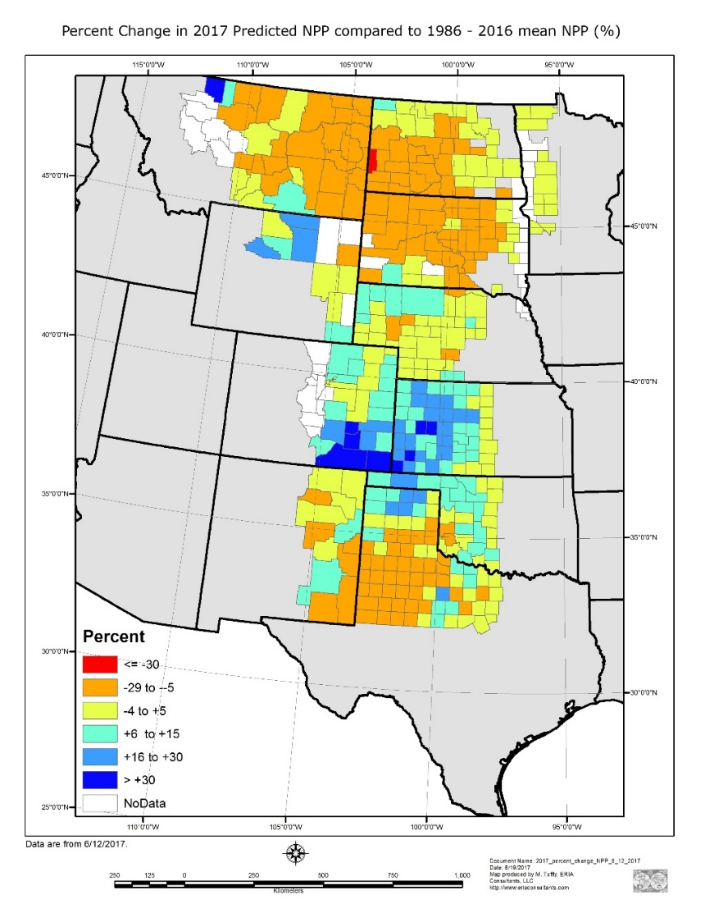
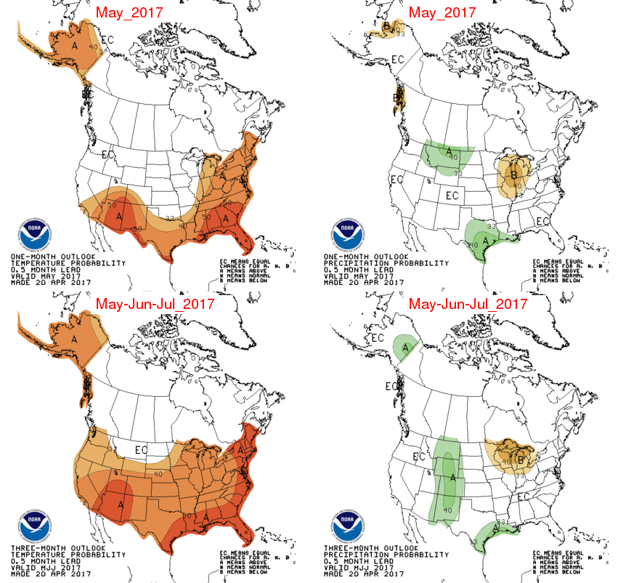
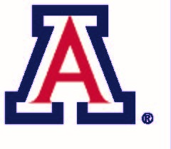
Making Weather Info Usable for Ag
Seasonal
Outlook
“Grass-Cast”
What IS this & what does it MEAN for me as a rancher???
Notes:
Dannele

Slide 9

Grassland Productivity Forecast “Grass-Cast”
“Based on
observed weather +
seasonal forecasts…
we expect grassland productivity in your county…
to be X% higher or lower than your county’s 30-year average.”
http://grasscast.agsci.colostate.edu
Notes:
Dannele
Productivity is short-hand for pounds per acre of vegetation.

Slide 10
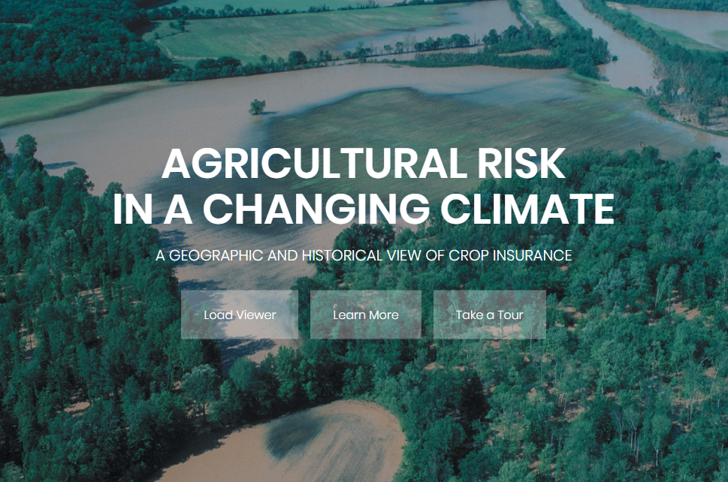
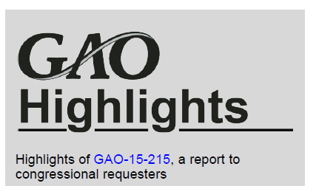
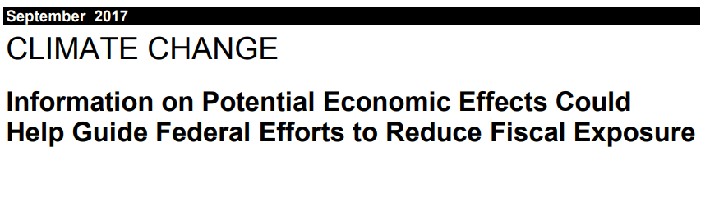
AgRisk Viewer
Interactive data viewer and analysis of insured crop losses
Insurance payments & acres
Cause of loss (e.g., drought, hail, excess moisture)
By crop, month, or year, at the county, state, or national level
https://swclimatehub.info/rma/
Notes:
Emile

Slide 11
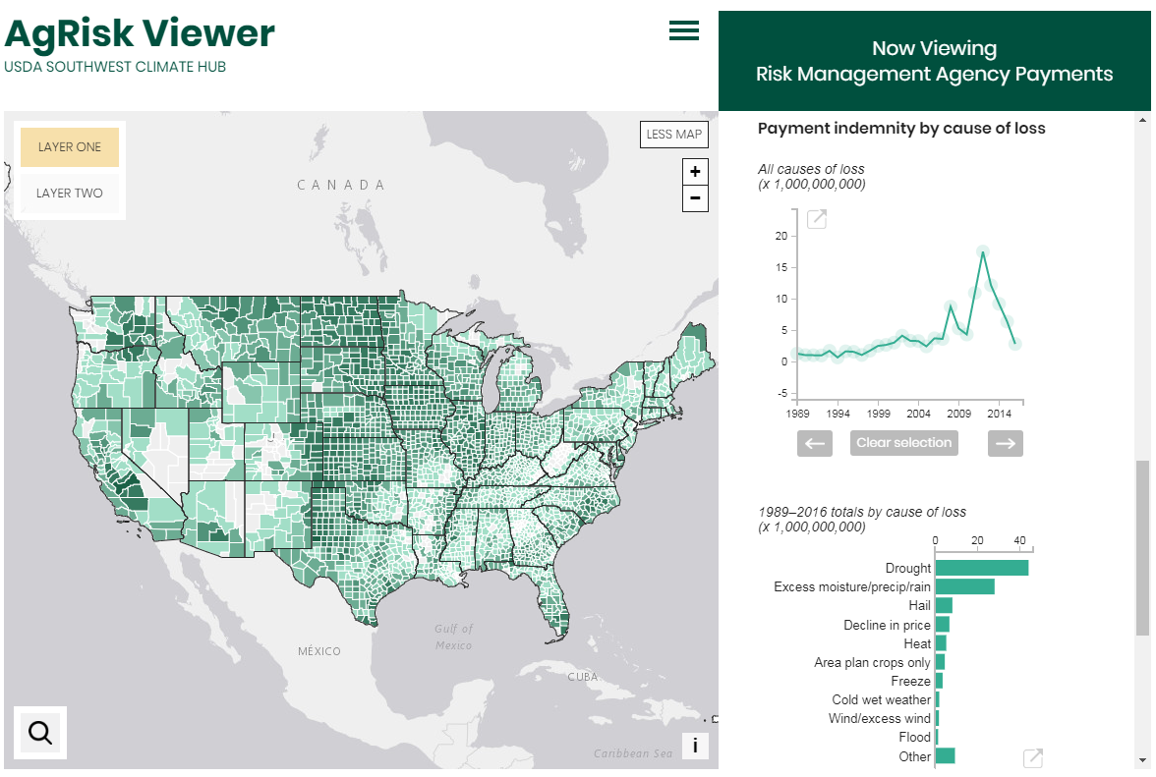
https://swclimatehub.info/rma/
Notes:
Emile

Slide 12
More Climate Hub Products…
ADAPTATION WORKBOOK
CROP SUITABILITY TOOL
GRASS-CAST
GULLY EROSION
PROJECT
EARLY SPRING
IMPACTS
RANGELAND VULNER.
ASSMT.
AGRISK
VIEWER
CATTLE HEAT STRESS ALERT
SOIL HEALTH
DAYS
EXTREME STORM
RESPONSE

Slide 13
Science Translation &
Information Synthesis
Notes:
Dannele

Slide 14
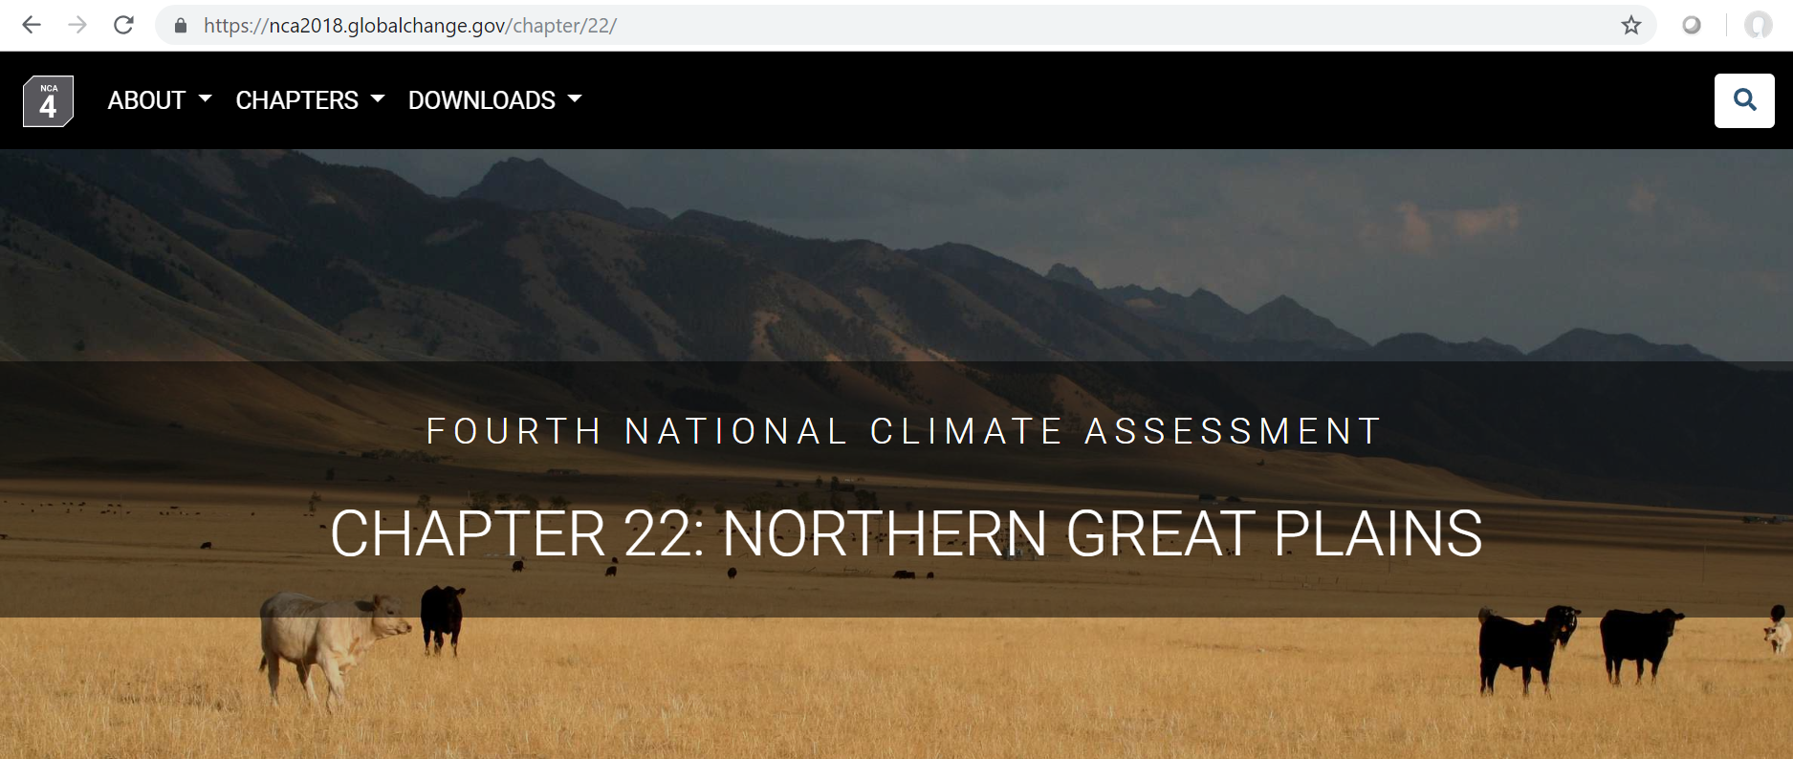
Science Synthesis
NCA4 Northern Great Plains (Chpt 22)
Agriculture ▪ Recreation & Tourism
  https://nca2018.globalchange.gov/chapter/22/

Slide 15
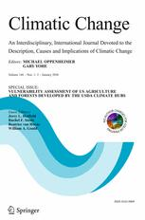
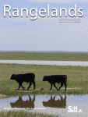
Science Translation & Synthesis
Special agriculture-focused issue in Climatic Change
  https://link.springer.com/journal/10584/146/1/page/1
Special drought-focused issue in Rangelands
  https://www.sciencedirect.com/journal/rangelands/vol/38/issue/4
Notes:
Dannele

Slide 16
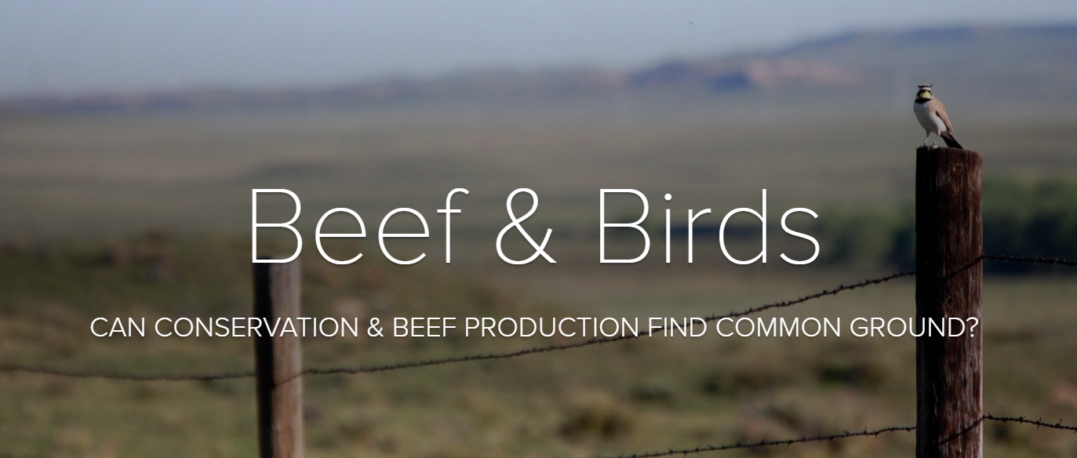
Science Translation
The story of USDA ARS’s Collaborative Adaptive Rangeland Management Project
Adobe Spark page by Hailey Wilmer et al.
https://spark.adobe.com/page/cDD9u5v5ZeC88/

Slide 17
Outreach & Education
Notes:
Dannele

Slide 18
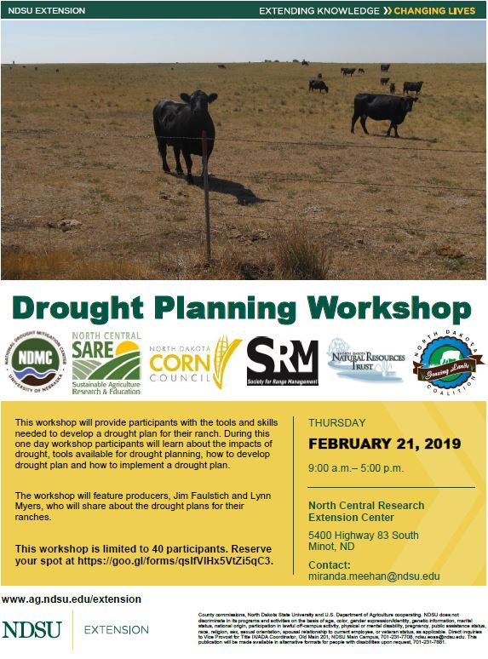
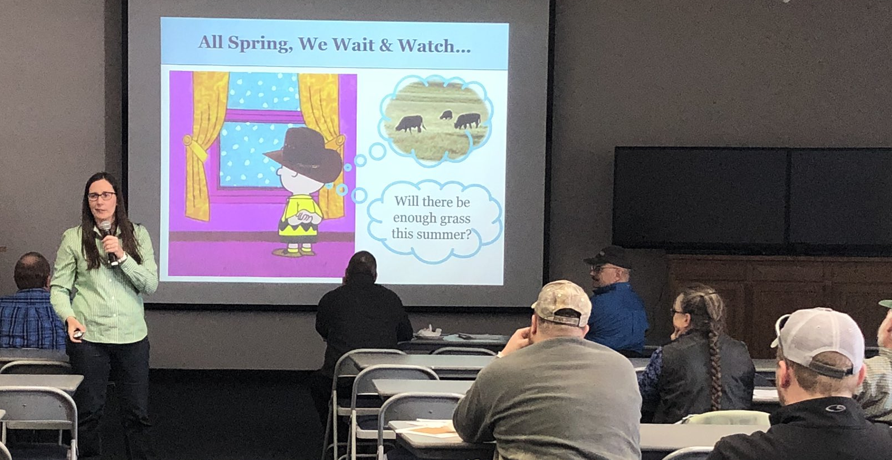
Drought
Planning
Workshop
Minot, ND
Feb 21, 2019

Slide 19
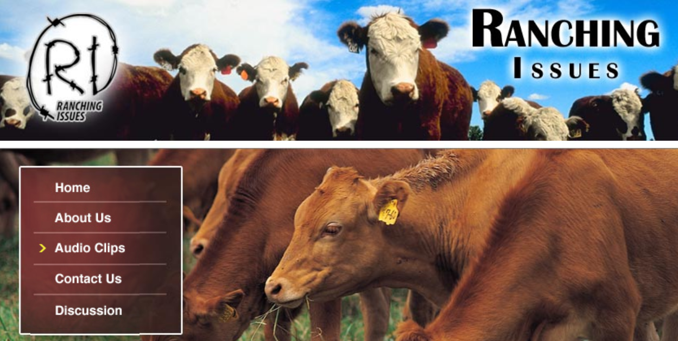
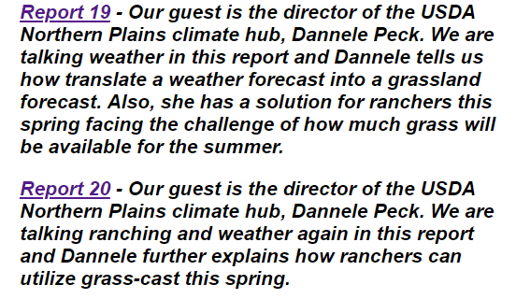
Drought
Planning
Workshop
Minot, ND
Feb 21, 2019
Notes:
RanchingIssues.com with Neil Roberts (?)

Slide 20
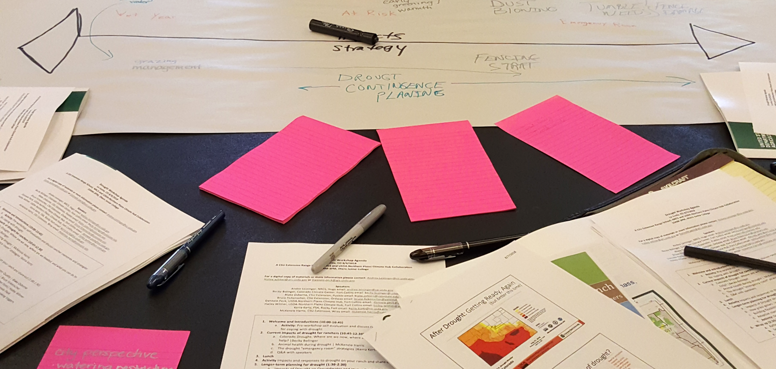
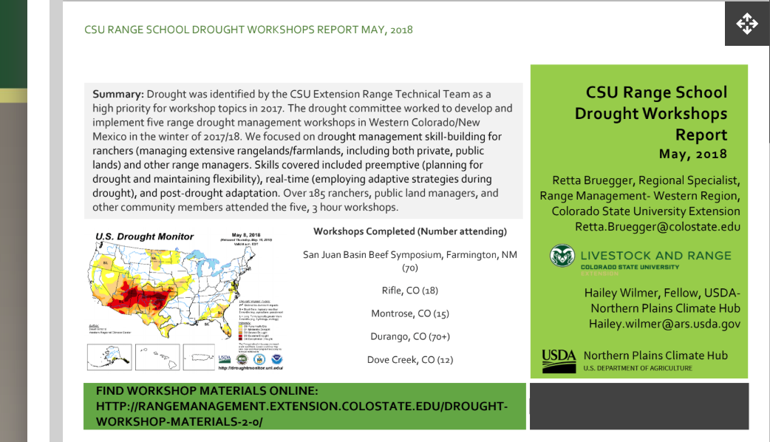


2018 Colorado
Drought Workshop
Notes:
Dannele, followed by Emile’s comments about SWCH’s FY18 Outreach including:
3 “drought” meetings in 2018
Ogden, Utah – Drought Monitor (FY19)
Belen, NM – livestock strategies
Farmington, NM - water and cropping strategies
Webinars hosted with NIDIS in July and October (made headlines with these!)
3 CoCoRaHS outreach events – 2 with Navajo Nation audiences

Slide 21
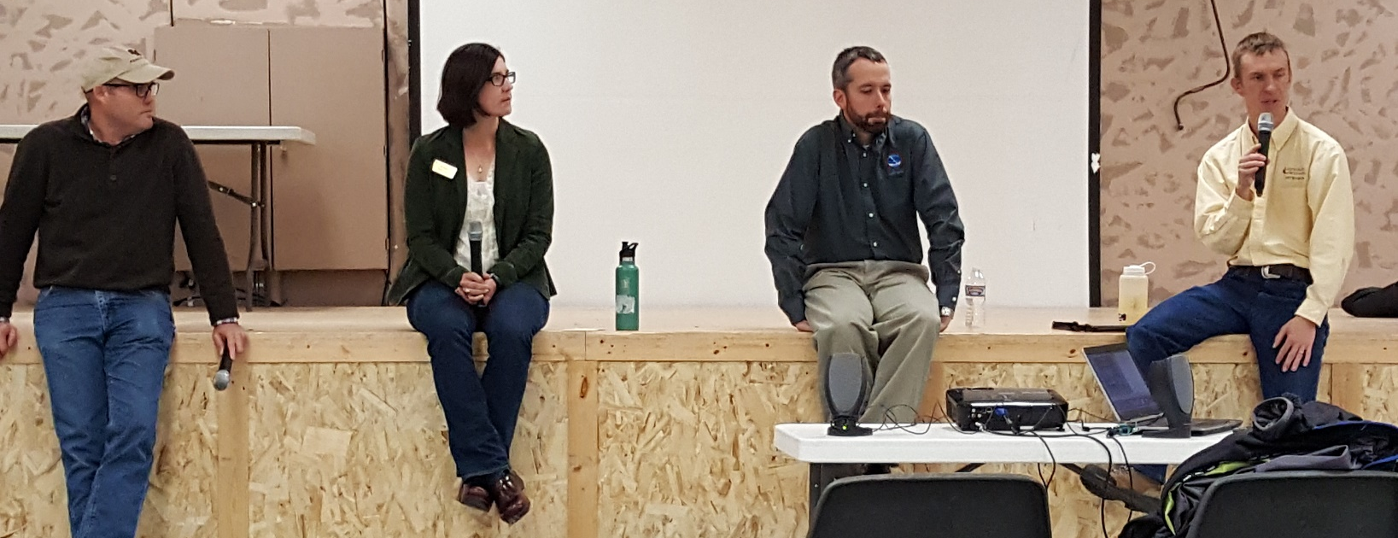
Partners in Outreach
We help Connect & Convene via
Workshops on wx challenges & resiliency in ag
Trainings to build ag ⬄ climate literacy
Joint presentations to & with stakeholders
  NIDIS, NWS, State Climate, Extension, Hub
Notes:
TOO Many Words
NIDIS, NOAA-NWS, NPCH, WY State Climate Office & UW Extension co-present at:
Southeast Wyoming Beef Production Convention, Torrington, WY
WY Stock Growers’ Winter Round-up, Casper, WY
Farm and Ranch Days, Riverton, WY
WESTI Ag Days, Worland, WY
Trainings for UW Extension professionals of available weather, climate, and drought resources

Slide 23
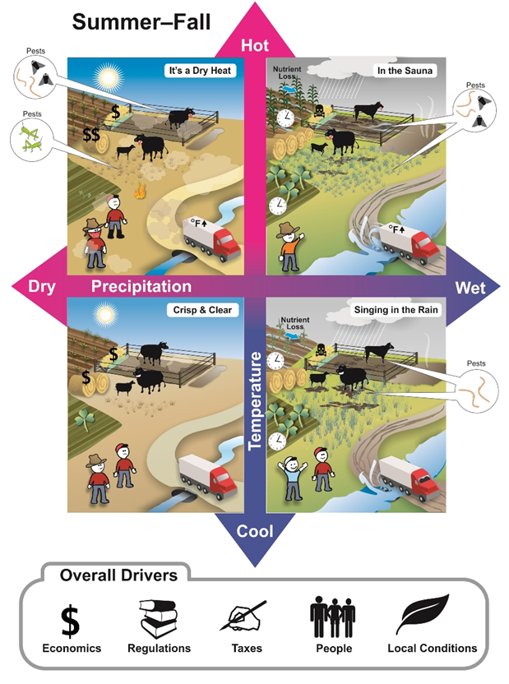
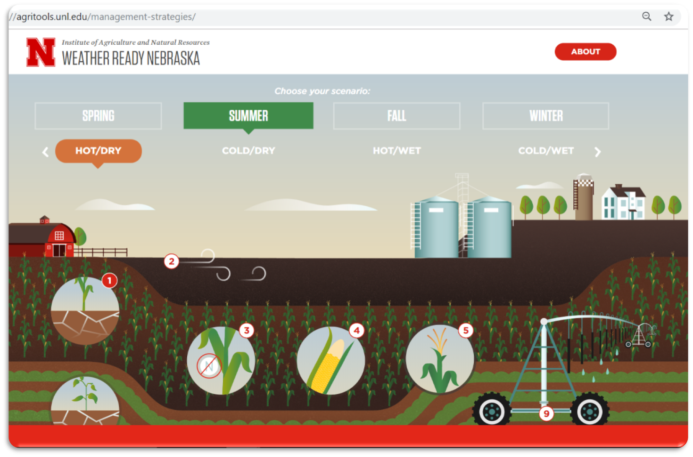
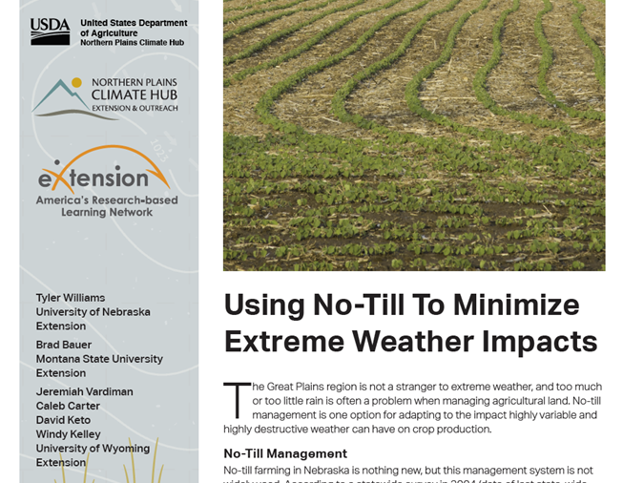
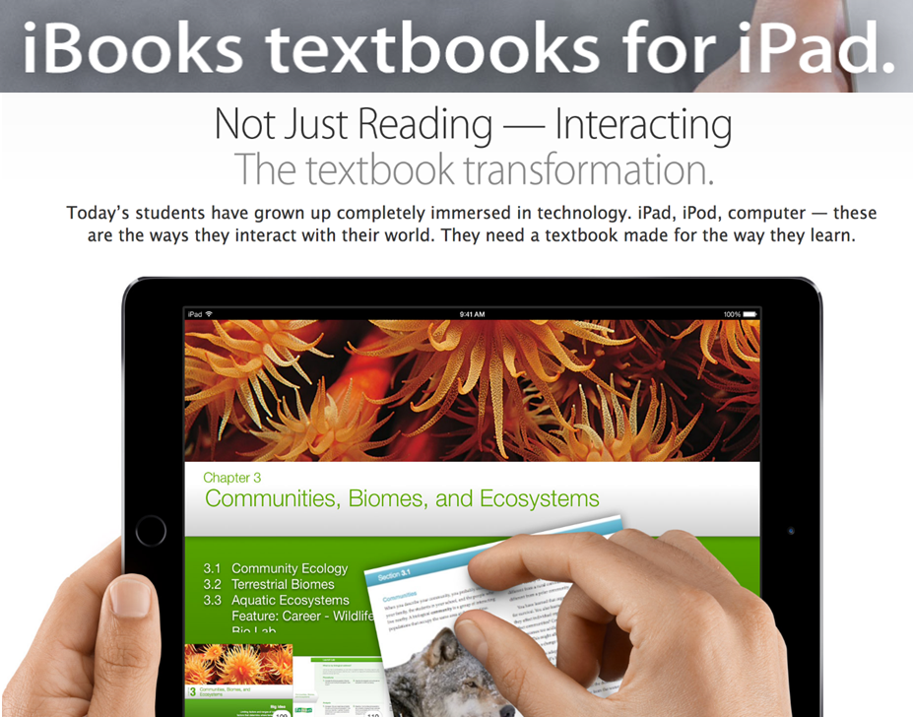
AgroClimate Outreach Exchange
March 25-26, 2019
Fort Collins, Colorado
6 Hub-funded Ext projects
Other E&O partners

Slide 24
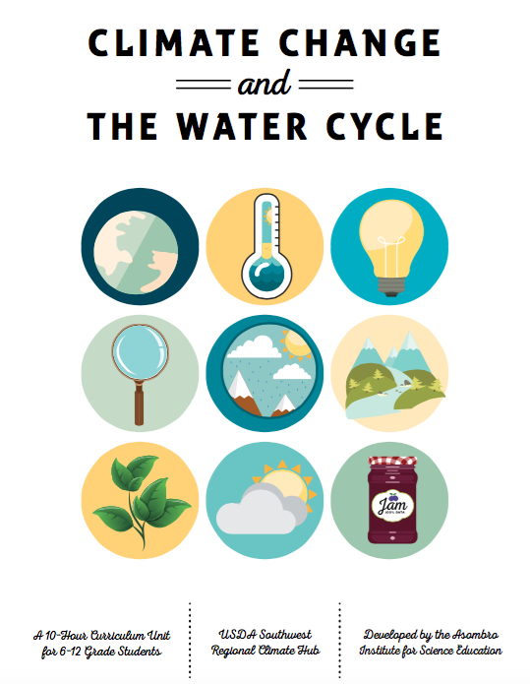
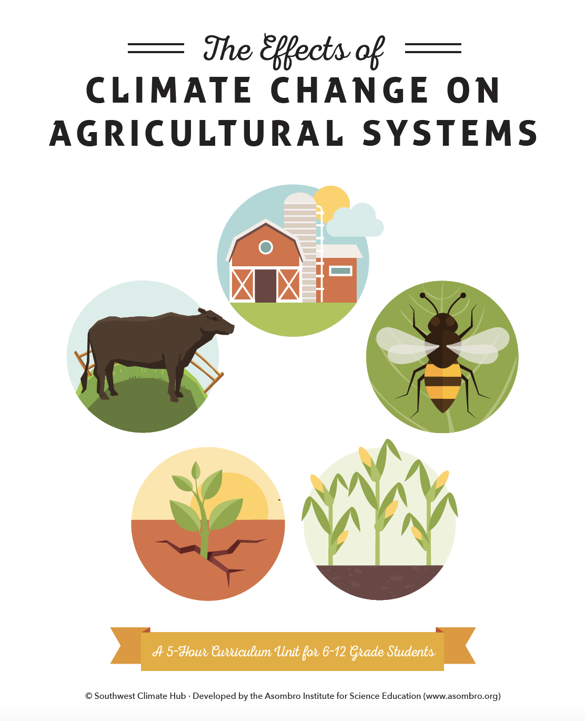
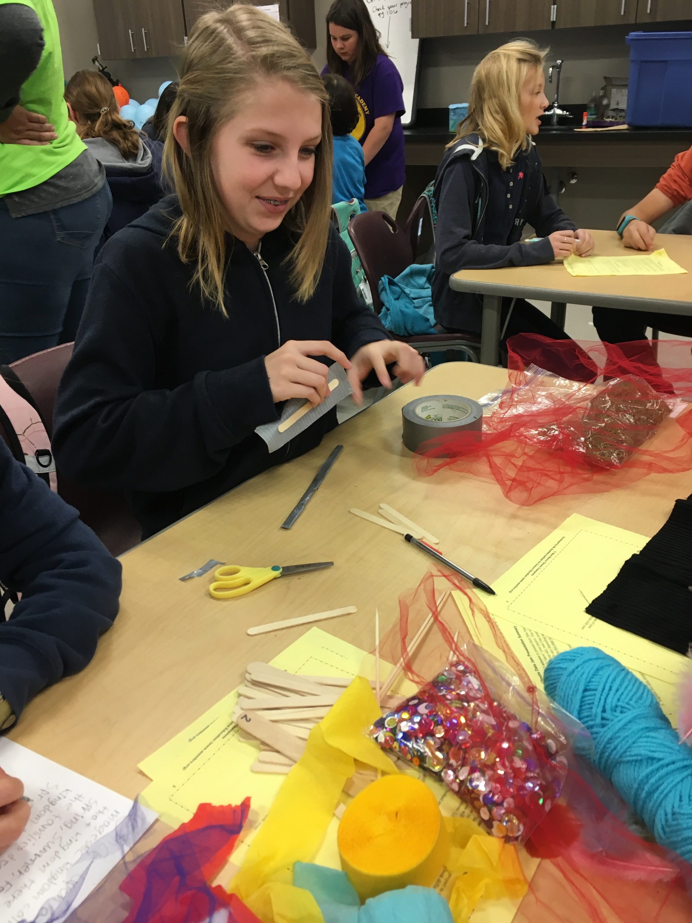
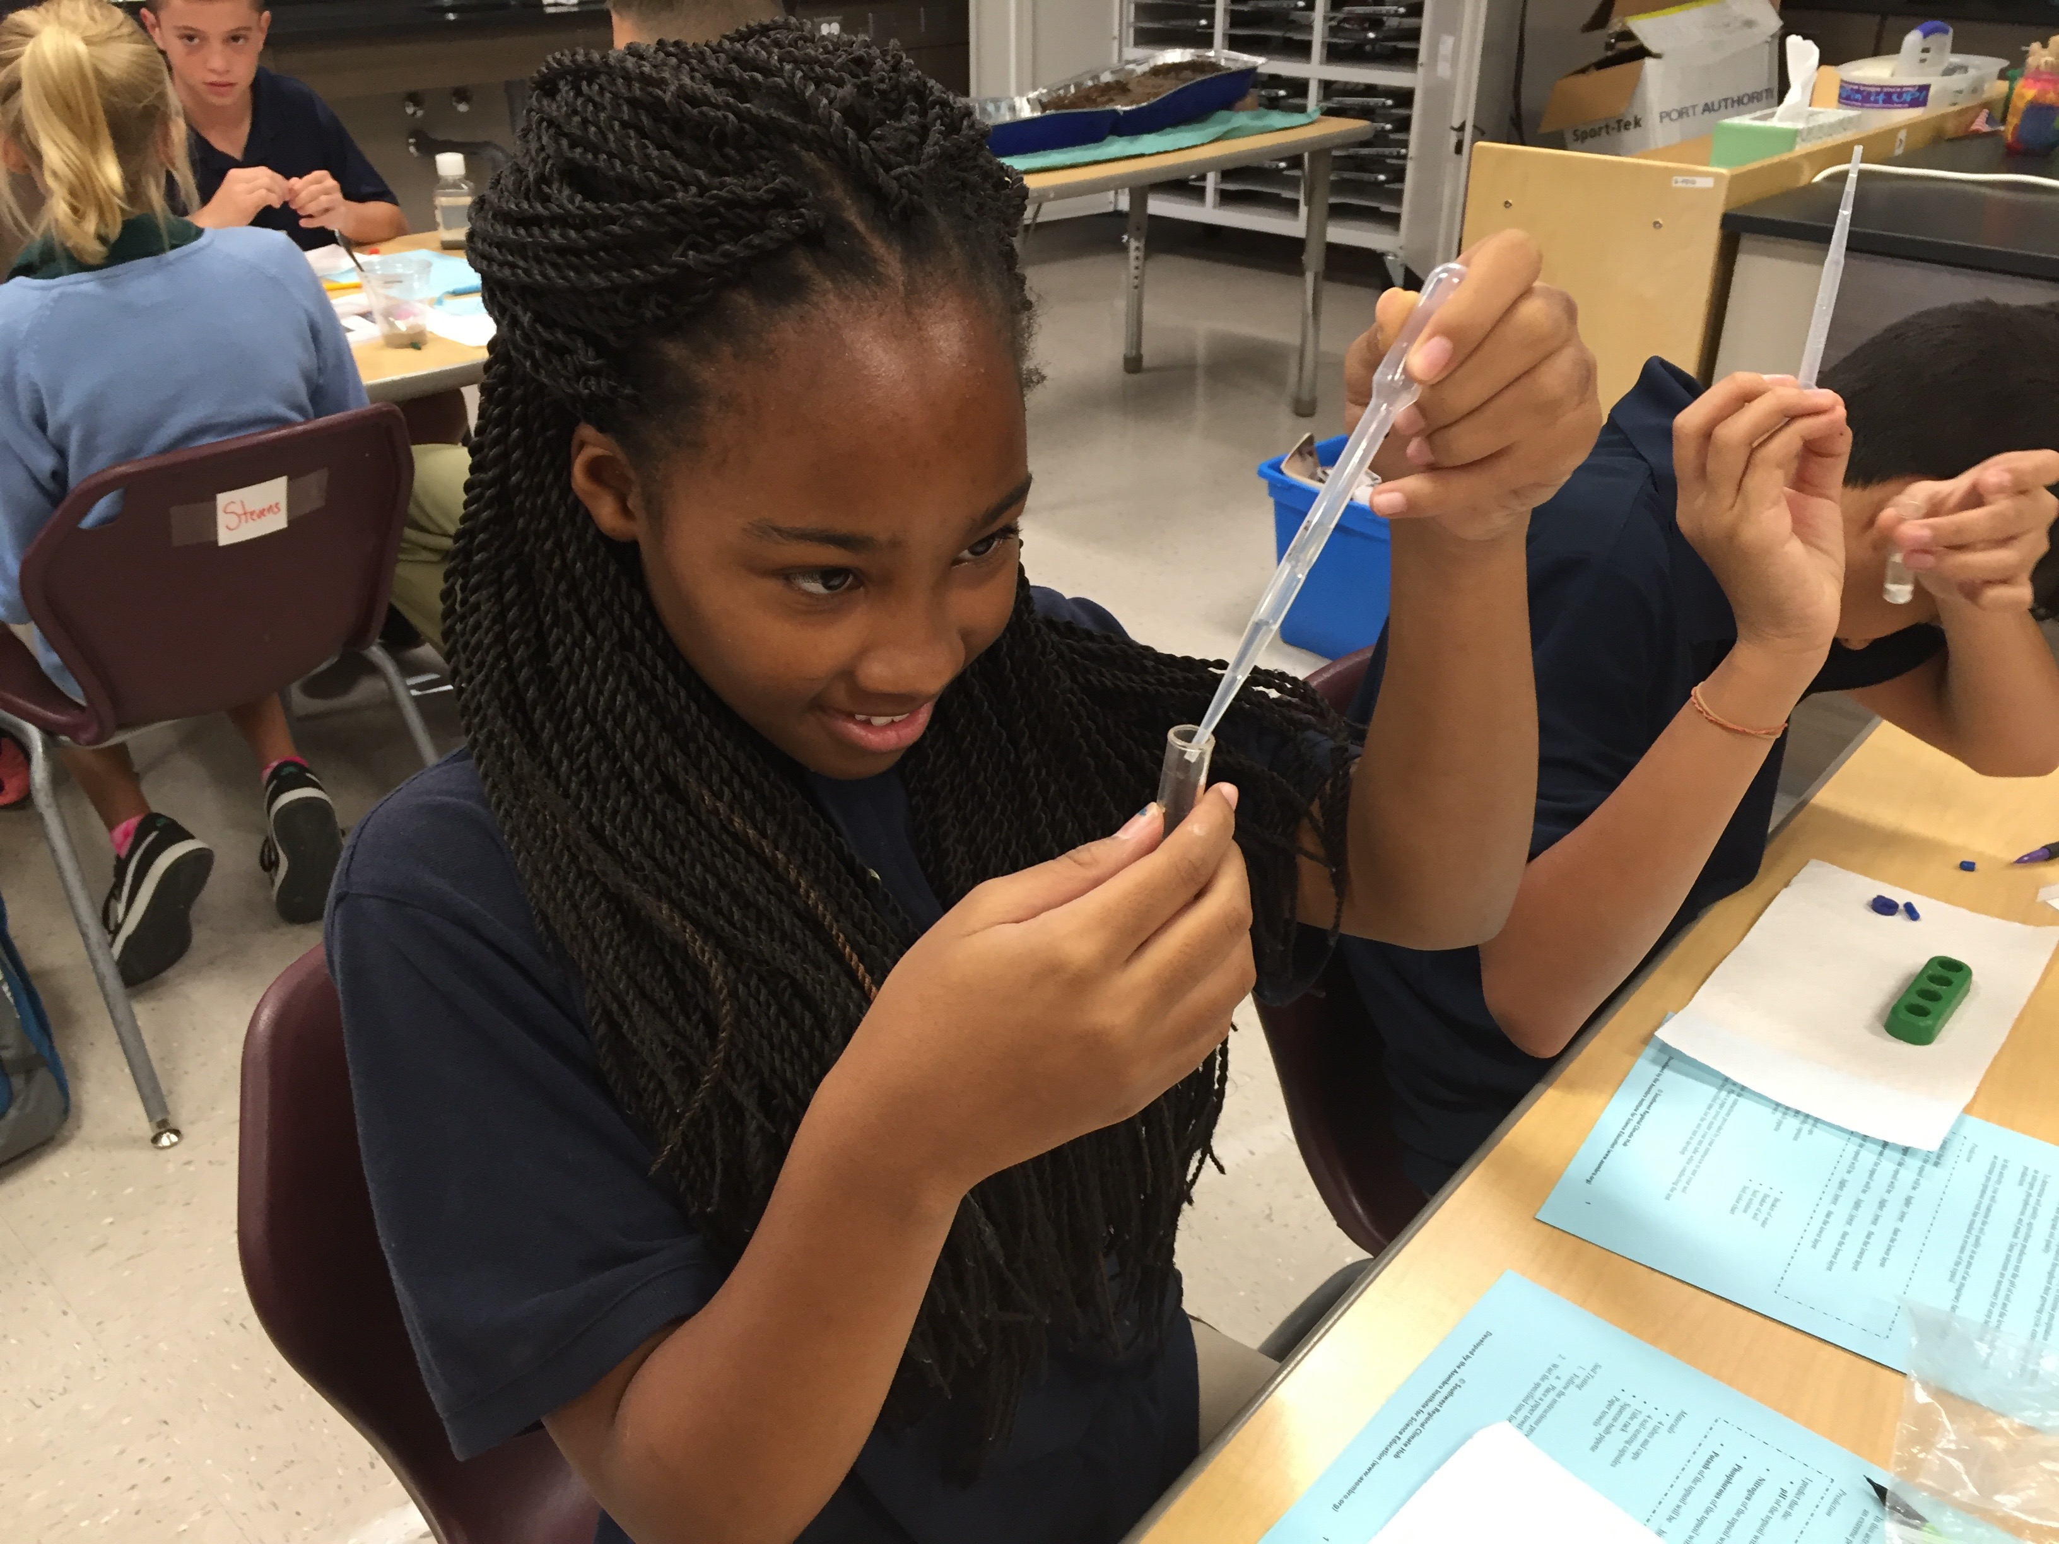
SW Hub: Ag & Water Cycle Education
2 middle & high-school units
14 hands-on activities
Next Generation Science Standards & Common Core State Standards
Widely available materials
  Sometimes NO additional materials required
Free download online:
http://bit.ly/WaterUnit
http://bit.ly/AgUnit

Slide 25
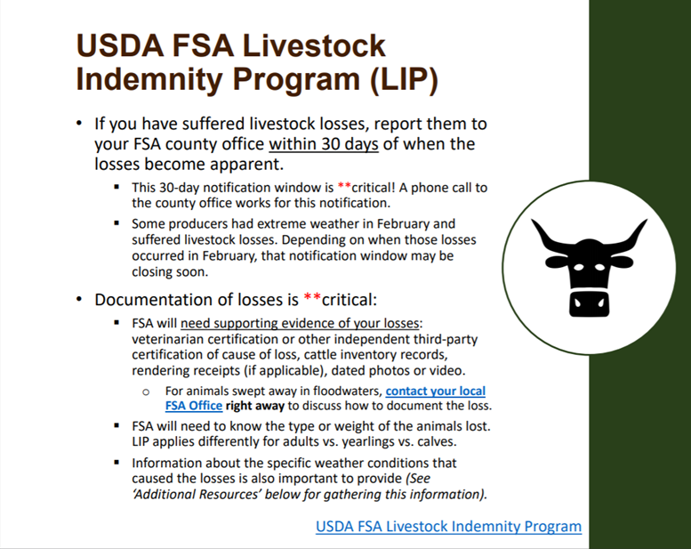
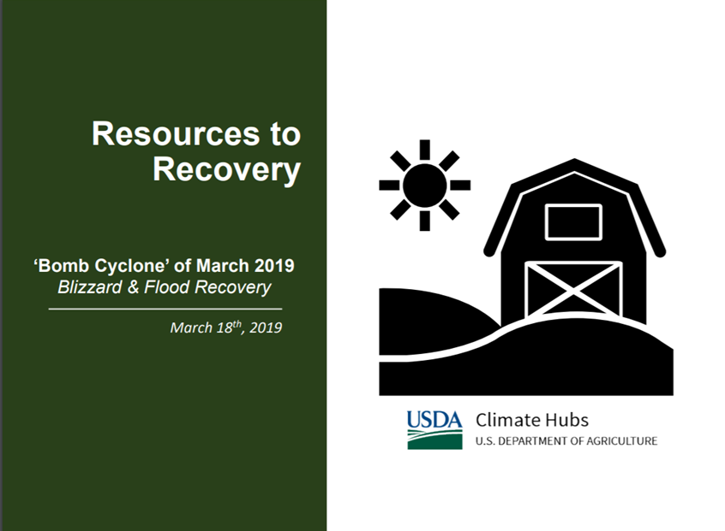
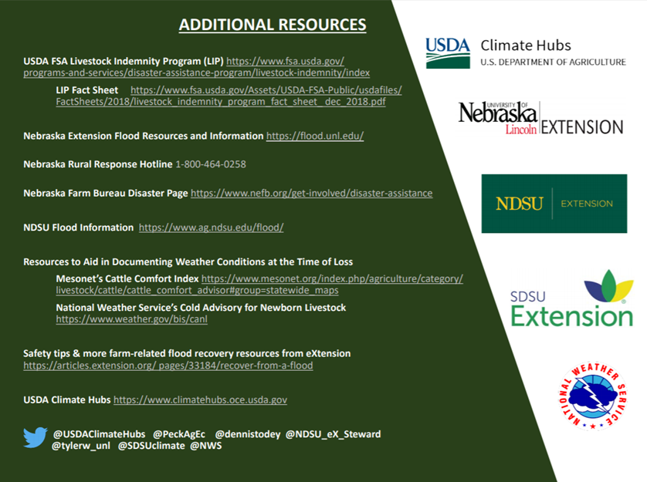
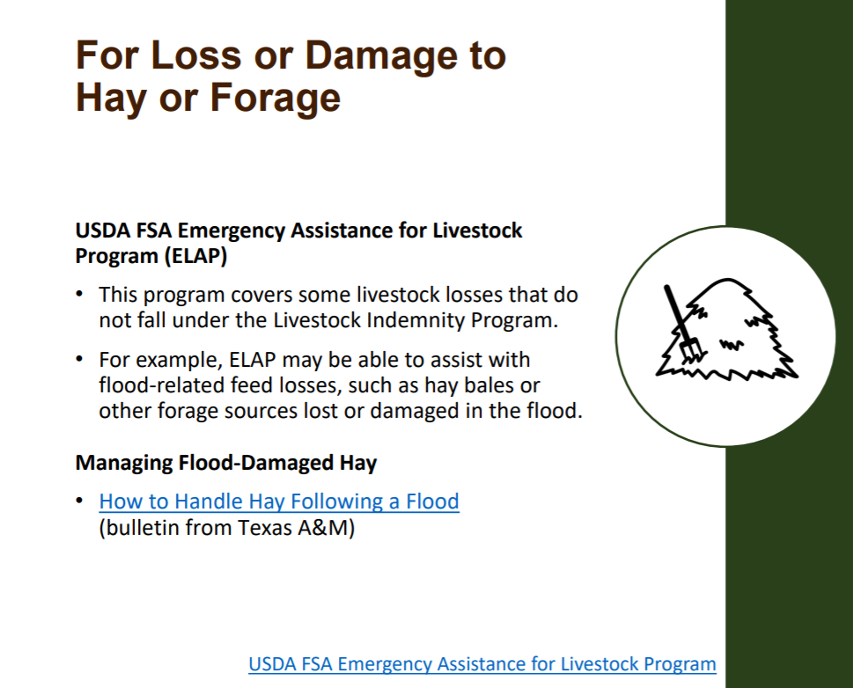
Connecting You to USDA Resources
Notes:
This effort was in partnership with the Midwest Climate Hub, NWS, and Extension specialists in 3 states: NE, SD, ND.

Slide 26
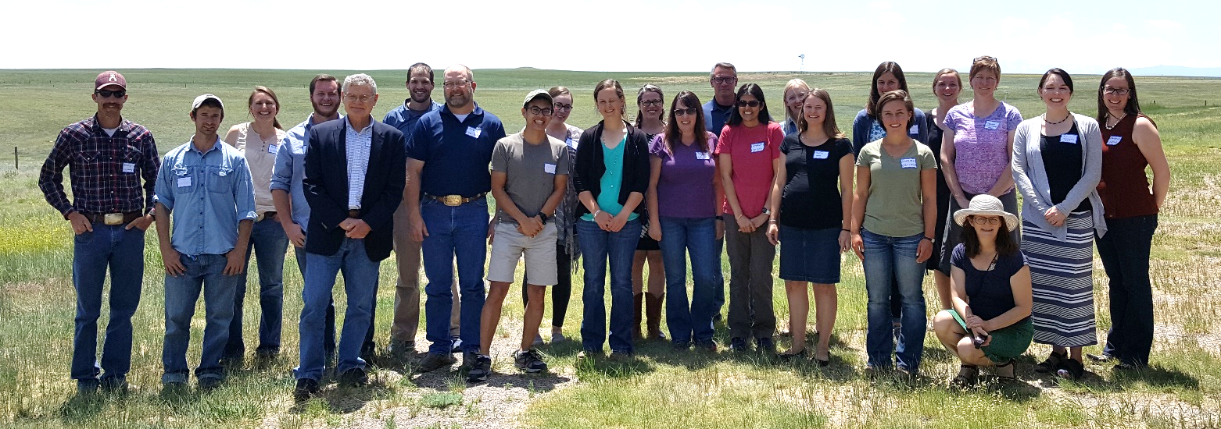
https://climatehubs.oce.usda.gov
Twitter: @USDAClimateHubs
What can we achieve together as partners?
Dannele Peck
NPCH Director
dannele.peck@ars.usda.gov
Twitter: @PeckAgEc
NCA4 Summaries for Ag in ND?
Agricultural News Articles?
Notes:
We look forward to exploring w/all of you what we might be able to achieve together as partners!
Please know you can contact the Northern Plains Climate Hub Director, Dannele Peck, or Coordinator, Windy Kelley, any time you have an “ag weather or climate” need or idea. Furthermore, each of the six states in the Northern Plains region have a Hub representative at their 1862 Land-Grant University, through the NPCH Extension & Outreach Team.
As you think about what varieties or when to plant this spring, consider any # of the resources available through the Hub and its partners – look, for example, at the seasonal forecast available at the “High Plains Climate Dashboard” (just Google this phrase).
Come irrigation season and scheduling – check out your state’s AgriMET resources through your State Climate Office – which provides daily ET measures to help estimate your crop’s water needs.
If your area is suffering from drought, help the National Drought Mitigation Center capture those conditions accurately by uploading photos and comments to the Drought Impact Reporter (just Google it). You can also volunteer to report the amount of precipitation in your area (especially if it’s ZERO) as a CoCoRaHS volunteer!
Contact Dannele, Windy or me (speaker) if you would like information about any of these resources.

